Slide 1
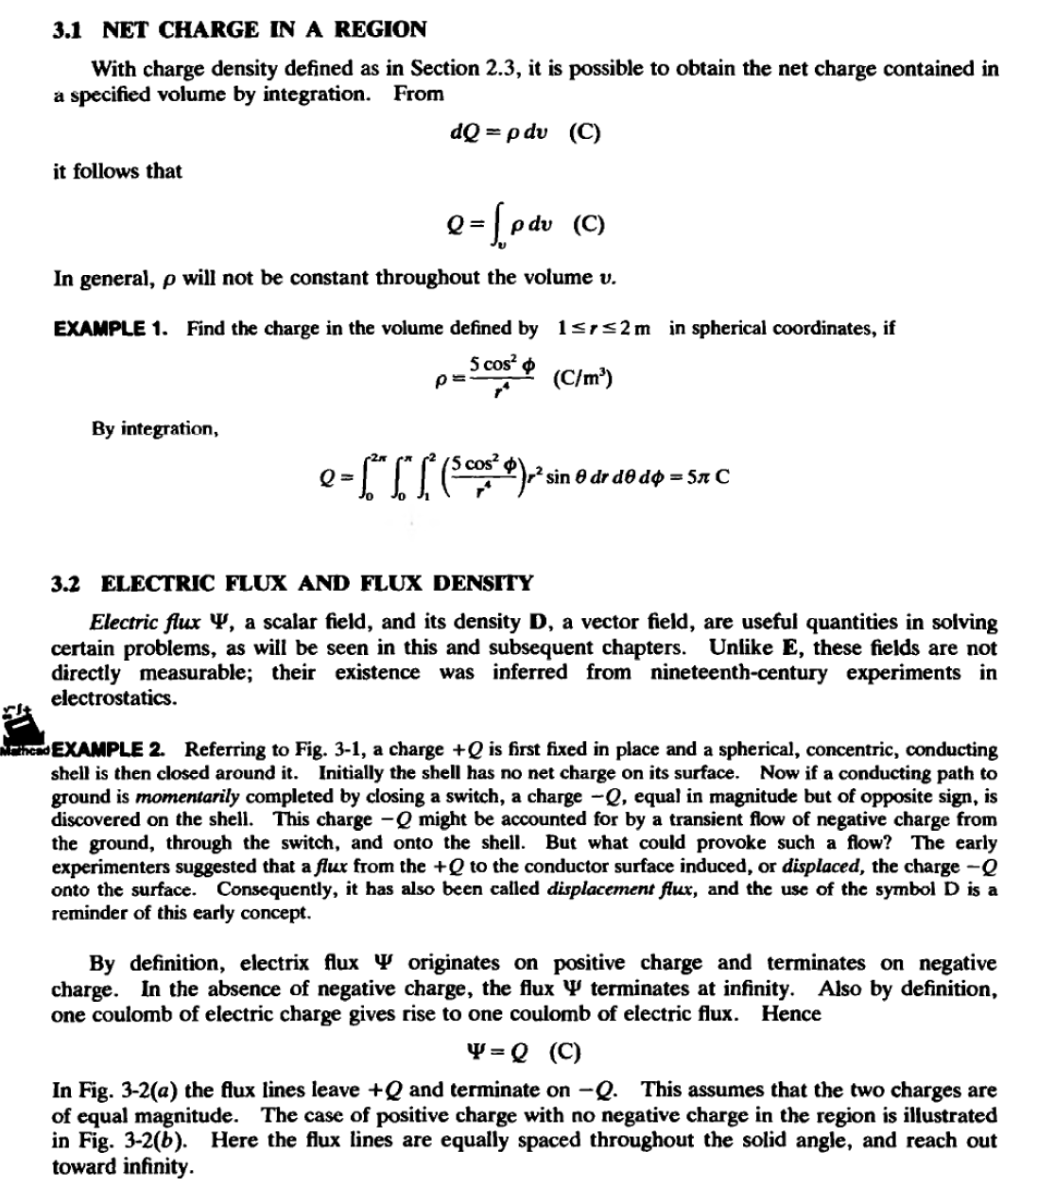
Lecture three/ Electric flux & Gauss law

Slide 2
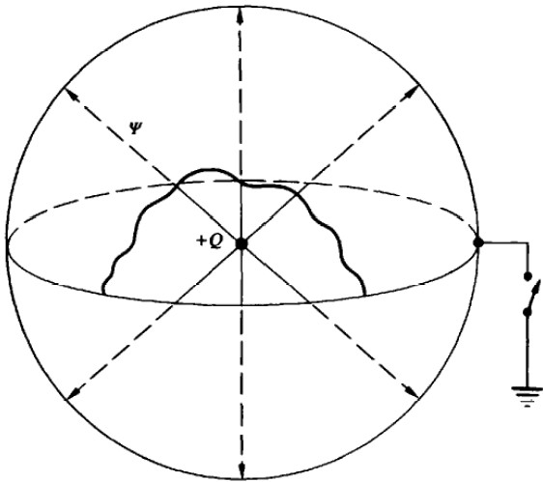

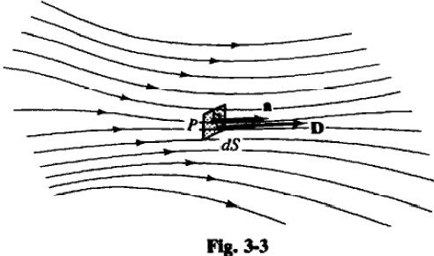
Jlla.3-1
\I
3
+Q•
-....;•-Q
!"\
(a) (b)
t'l&·3-Z
H in the neighborhood of point P the lines of flux have the direction of the unit vector a (see Fig. 3-3) and if an amount of flux dW crosses the differential area dS, which is a normal to a, then the electric flux density at P is
A volume charge distribution of density p (C/m³ is shown enclosed by surface S in Fig.
)
3-4. Since each coulomb of charge Q has. by definition, one coulomb of flux 'I', it follows that the net flux crossing the closed surfaceS is an exact measure of the net charge enclosed. However, the

Slide 3
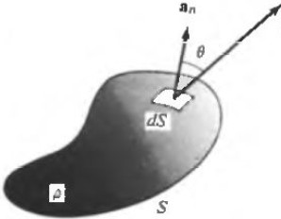
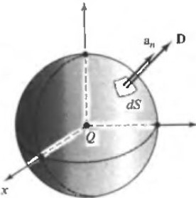
density D may vary in magnitude and direction from point to point of S; in general , D will not be along the normal to S. If, at the surface element dS, D makes an angle 8 with the normal, then the differential flux crossing dS is given by
d'P = D dS cos 8 = D • dSa, = D • dS
where dS is the vector surface element, of magnitude dS and direction an. The unit vector a, is always taken to point out of S , so that d'l! is the amount of flux passing from the interior of S to the exterior of S through dS.
D
Fig.3-4
  GAUSS' LAW
Gauss' law states that The total flux out of a closed surface is equal to the net charge within the
surface. This can be written in integral form as
fD·dS= Qenc
A great deal of valuable information can be obtained from Gauss' law through clever choice of the surface of integration; see Section 3.5.
  RELATION BE1WEEN FLUX DENSITY AND ELECTRIC FIELD INTENSITY
Consider a point charge Q (assumed positive, for simplicity) at the origin (Fig. 3-5). If this is enclosed by a spherical surface of radius r, then , by symmetry, D due to Q is of constant magnitud e over the surface and is everywhere normal to the surface. Gauss' law then gives
Q =f D • dS = D f dS = D(4.n:r²
)
z
y
Fig. 3-5

Slide 4
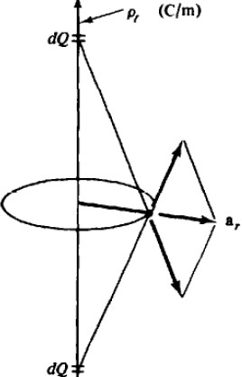
from which D = Q/4rrr²
Therefore
D=-^{Q}a,. =-^{Q}-a
4rrr² 4.m-² '
But, from Section 2.2, the electric field intensity due to Q is
Q
E =--
a
41rEoT2 ,
It follows that D = EoE.
More generally, for any electric field in an isotropic medium of permittivity E,
D=EE
Thus, D and E fields will have exactly the same form, since they differ only by a factor which is a constant of the medium. While the electric field E due to a charge configuration is a function of the pennittivity E, the electric fiux density Dis not. In problems involving multiple dielectrics a distinct advantage will be found in first obtaining D, then converting toE within each dielectric.
  SPECIAL GAUSSIAN SURFACES
The surface over which Gauss' law is applied must be closed. but it can be made up of several surface elements. If these surface elements can be selected so that D is either normal or tangential, and if IDI is constant over any element to which D is normal, then the integration becomes very mple. Thus the defining conditions of a special gau.f.fian .'iurface are
    The surface is closed.
2. At each point of the surface D is either normal or tangential to the surface.
3. D is sectionally constant over that part of the surface where D is normal.
EXAMPLE 3 Use a special gaussian surface to find D due to a uniform line change p, (C/m).
Take the line charge as the z axis o( cylindrical coordinates (Fig. 3-6). By cylindrical symmetry, D can
00

Slide 5
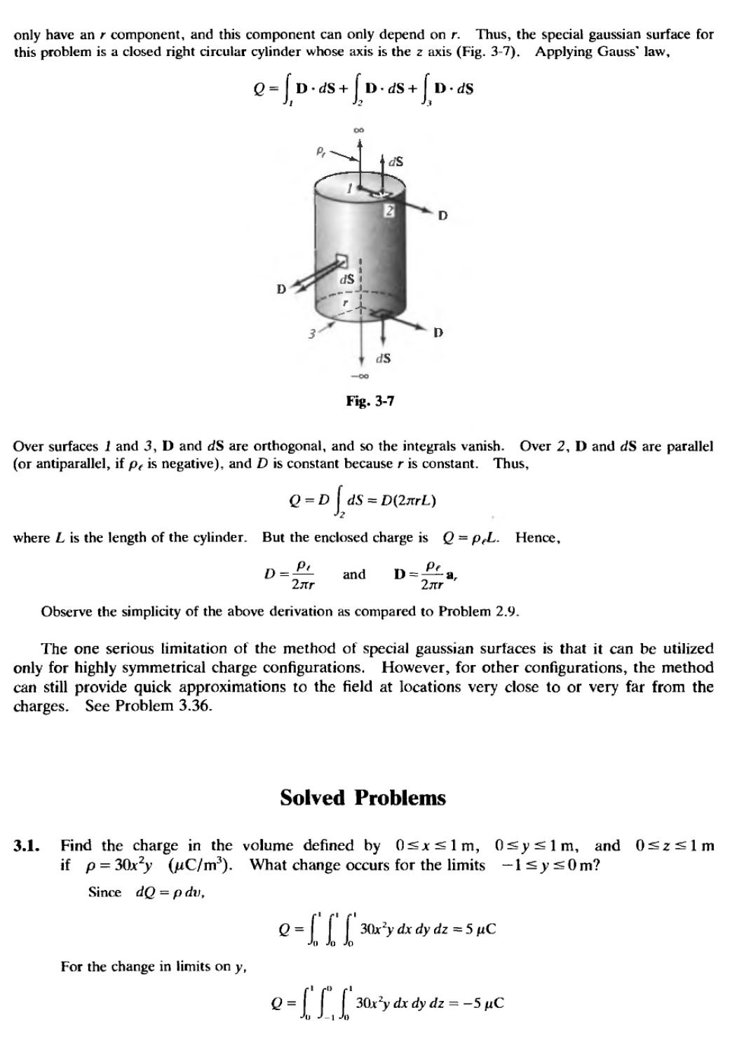

Slide 6
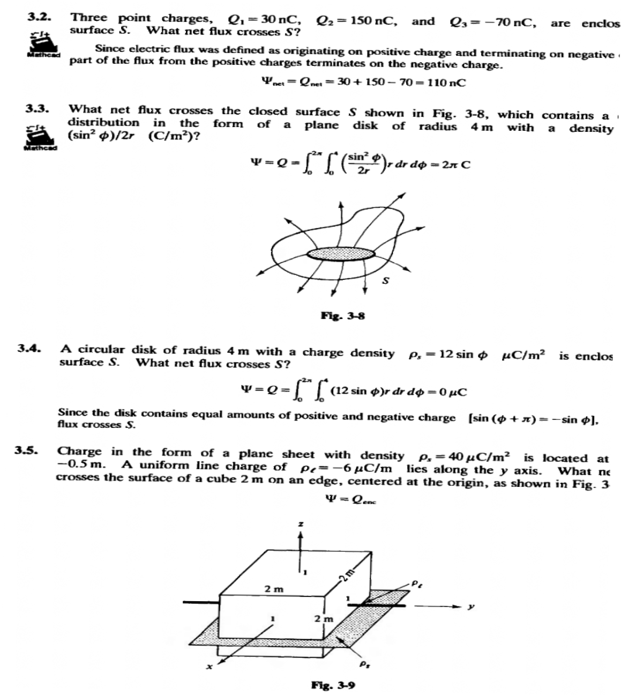

Slide 7
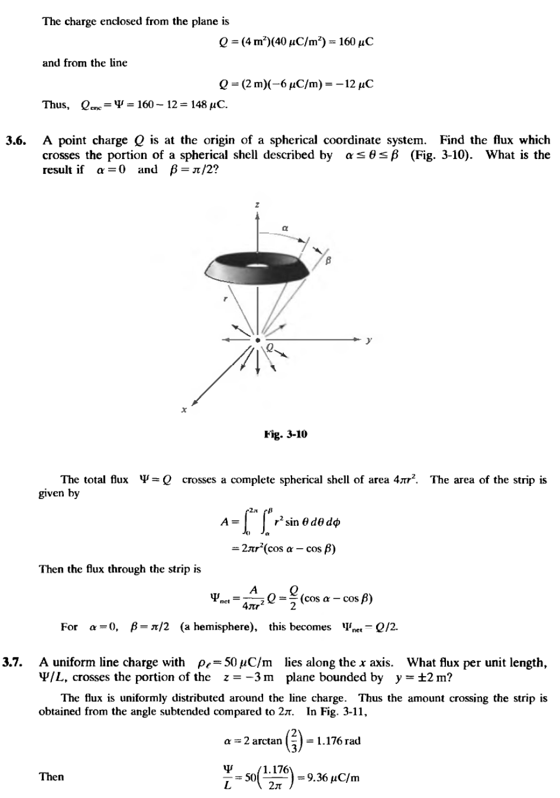

Slide 8
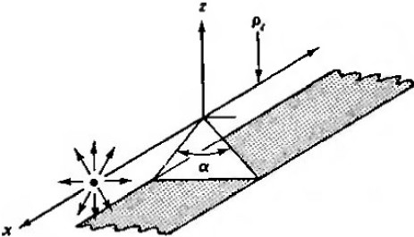
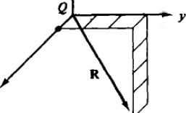
3.8.
A point charge, Q = 30 nC, is located at the origin in cartesian coordinates. electric flux density D at (1, 3, -4) m.
Referring to Fig. 3-12,
Q
D•4 rR1a"
Find the
= 30 x 10-⁹ + 3a,. -4a.)
(•·
4 r(26)
Vi6
=(9.18x 10-¹¹)(•.. +³a,. -⁴⁸•) C/m²
v26
or, more conveniently , D = 91.8pC/m²
•
(1, 3,-4)
\D
fll·3-ll
3.9.
Two identical uniform line charges lie along the x and y axes with charge densities p,=
20 p.C/m. Obtain D at (3,3,3) m.
1be distance from the observation point to either line charge is 3v2 m. Considering first the line charge on tbe x axis,
_{D,}_₋ p _{,,-} 20 1-1C/m ( )
-
2m', 21r(3v'2 m) v'2
and now they axis line charge,
D, = p ar'2 == 20 1-'C/m (•.. +• )
2m'z 21r(3v'2 m) Vi

Slide 9
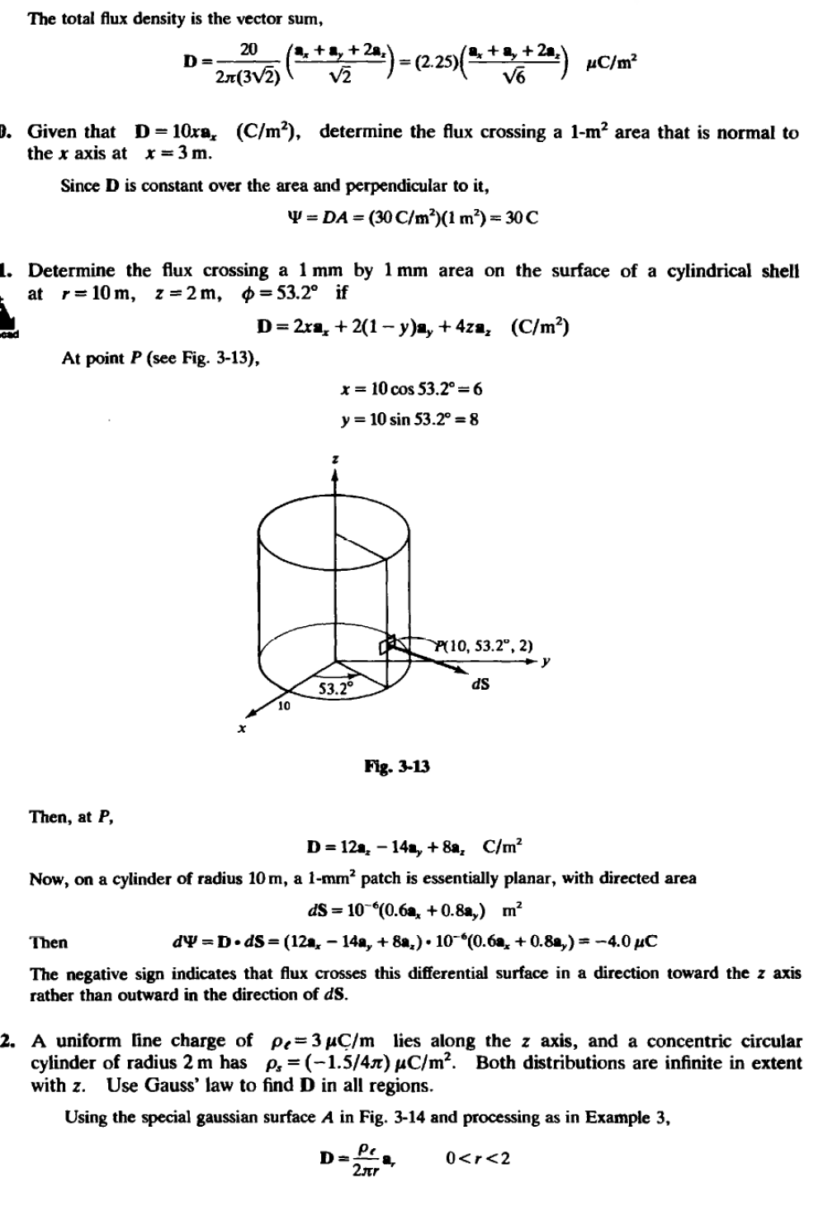

Slide 10
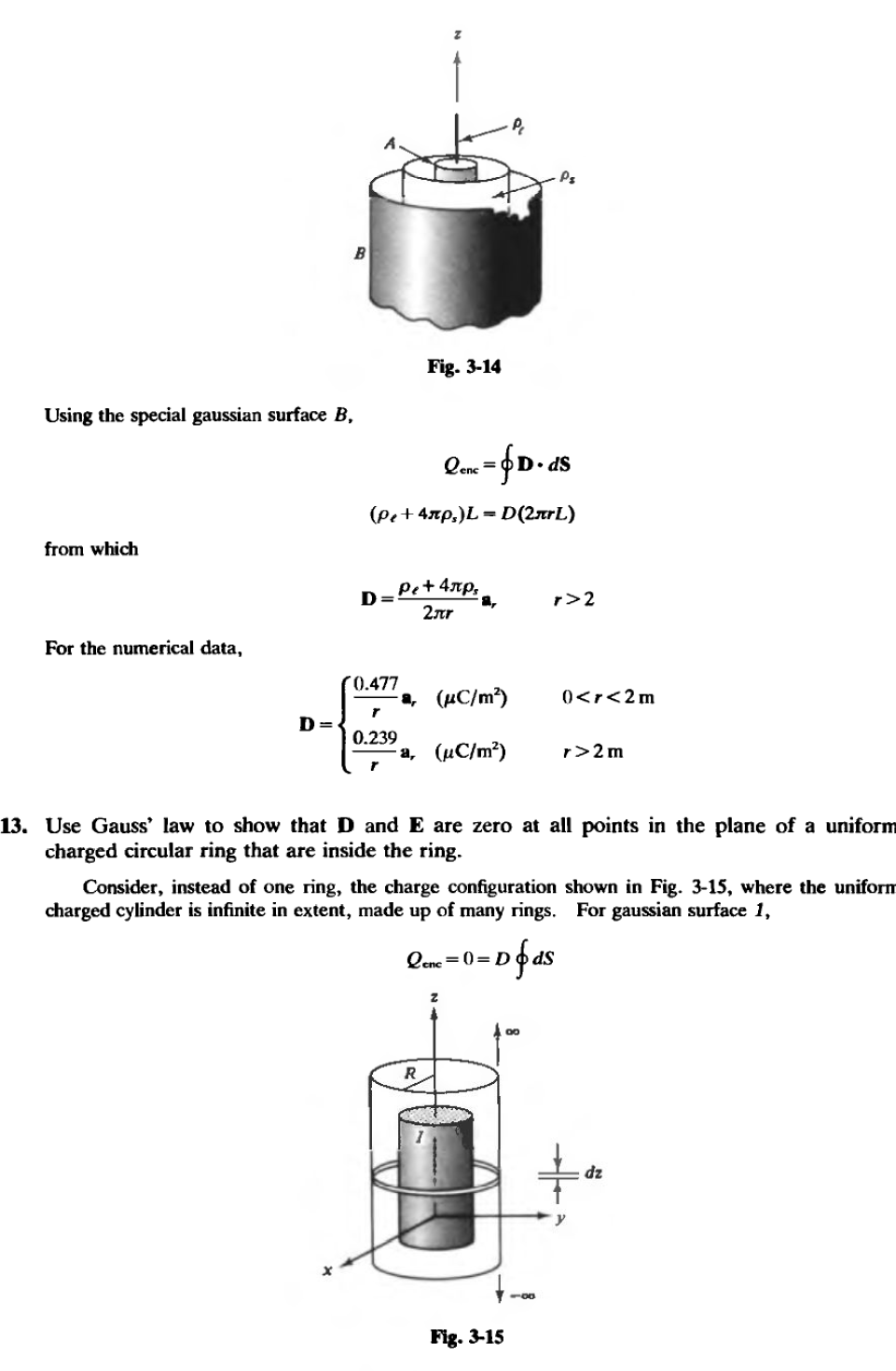

Slide 11
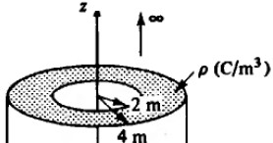
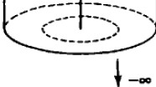
Hence D- 0 for r < R. Since 'II is completely in the radial direction ,a slice dz can be taken from tbe c:ylinder of charge and the result found above will stiU apply to this ring. For all points within the ring, in the plane of the ring, D and E are zero.
A charge configuration in cylindrical coordinates is given by p- Sre- (C/m³ .
) Use
Gauss' law to find D.
Since p is not a function of •or z. the flux 'II is completely radial. It is also true that, for r constant, the ftux density Dmust be of constant magnitude. Then a proper special gaussian surface is a closed ript circular cylinder. The integrals over the plane ends vanish, so that Gauss' law becomes
Q....-f,_.o·dS
_...,
f L:.[ Sre-z.rdrdq>dz •D(2ruL)
S.nL(e-z.(-r-r- i) + l} •D(2nrL)
D• · (I-e-z-(,.: +r + ma, (C/m²
Hence
2 5
)
r
'• Tbe volume in cylindrical coordinates between r = 2 m and r =4 m charge density p (C/m³ .
contains a uniform
From Fia. 3-16, for
) Use Gauss' law to find Din aU regions.
O < r<2m,
Q...-D(2m-L)
o-o
lila·3-16
For 2 :S r :S4 m,
.npL(,-%- 4) •D(21frL)
D =;_(r-4)a. (C/m
For r > 4m,
121fpL •D(21frL)
6p
D=-a, (C/m²
)
r

